Slide 1
Dog Recognition Convolution Neural Network (Transfer Learning )
Group Member:
CHRISTY, CHAN HIO LAM (MB955702)
EDISION, UN CHON WAI (MB955370)
VONG EUGENE IN CHI (MB955533)

Slide 2
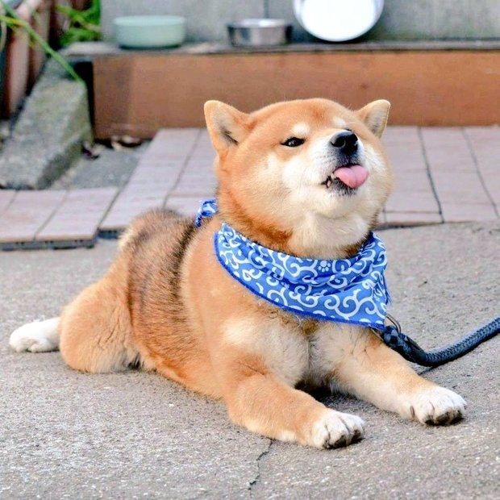
Stanford Dogs Dataset
Number of classes: 120
Number of images: 20,580
(224*224)
Size: 757MB
Data format: jpeg
Training Set: 70%
Testing Set: 30%
Hi! I am a Shiba Inu 🐶
I am not included in the 120 breeds
http://vision.stanford.edu/aditya86/ImageNetDogs/

Slide 3
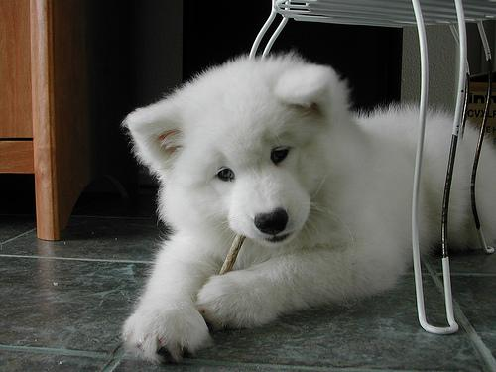
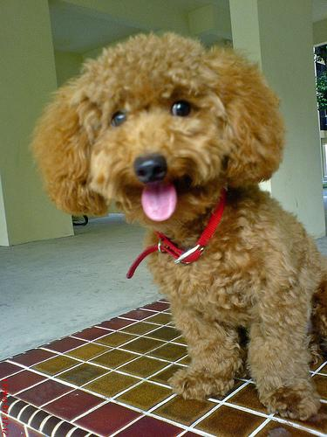
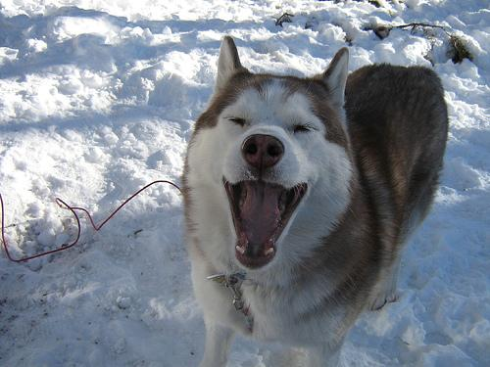

Slide 4

Libraries Used
Keras
High-level building blocks → deep learning
Backend : PlaidML
Model: MobileNetV2
Numpy
Matplotlib
My name is Keras and
nice to meet you!

Slide 5
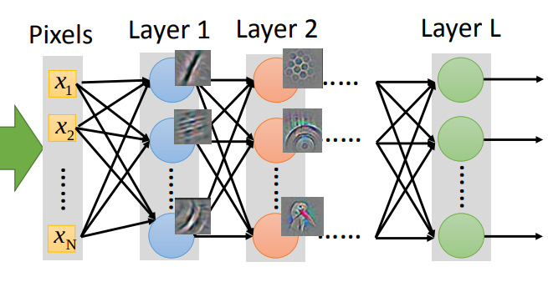
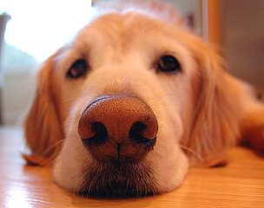
CNN – Transfer Learning
Reduce Noise
Data Annotation – Chop off useless pixels
Process Data
Convolution
Max Pooling
Data augmentation
Data Set *2
Result (forecasting)
Dog Recognition
Top 3 Accuracy: 94.7522%

Slide 6
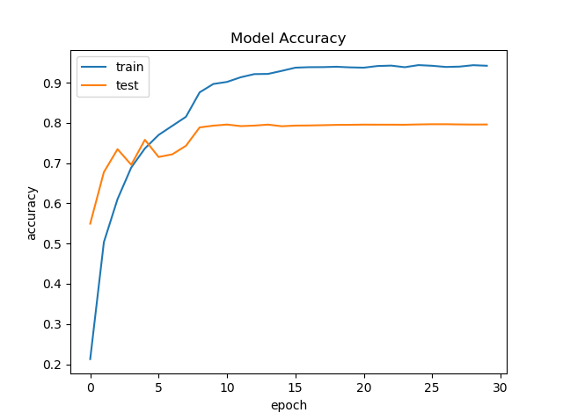
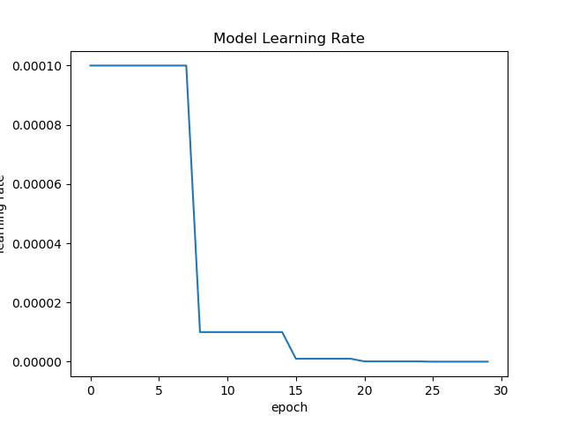
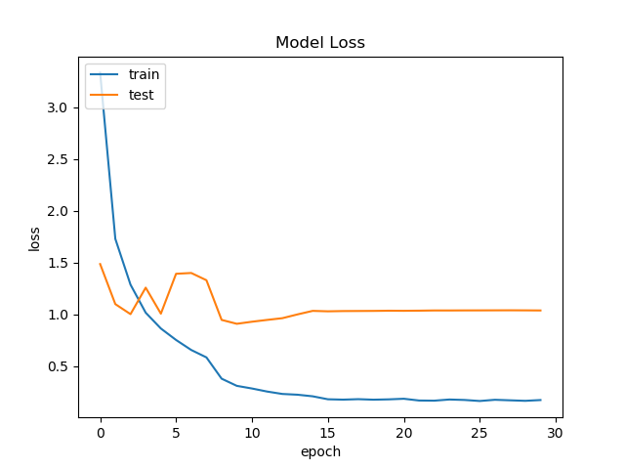

Slide 7
Learning rate
gradually descending
1 x 10⁻⁴ --> 1 x 10⁻⁸
2 Hidden layers
Rectified Linear Unit (ReLu) activation function
Dropout layer
Prevent Overfitting model

Slide 8
Thanks!
Wanna Try?
Just Airdrop the photo to us!
See you guys next semester!!
IF you like it, just give us a star: https://github.com/Chonwai/DogRec

